Slide 1
Material Management System

Slide 2
What is Material Management System?
Material Management System is a solution to control and monitor day-to-day transactions from material request to purchasing to supplier to warehouse to end user.

Slide 3







Process Visualization
Requestor
Mail Notification
For Review
Mail Notification
For Approval
Create PO
Notify Requestor /
End User
WH Receiving
Forward PO to
Supplier
Top management
Review and Approval

Slide 4
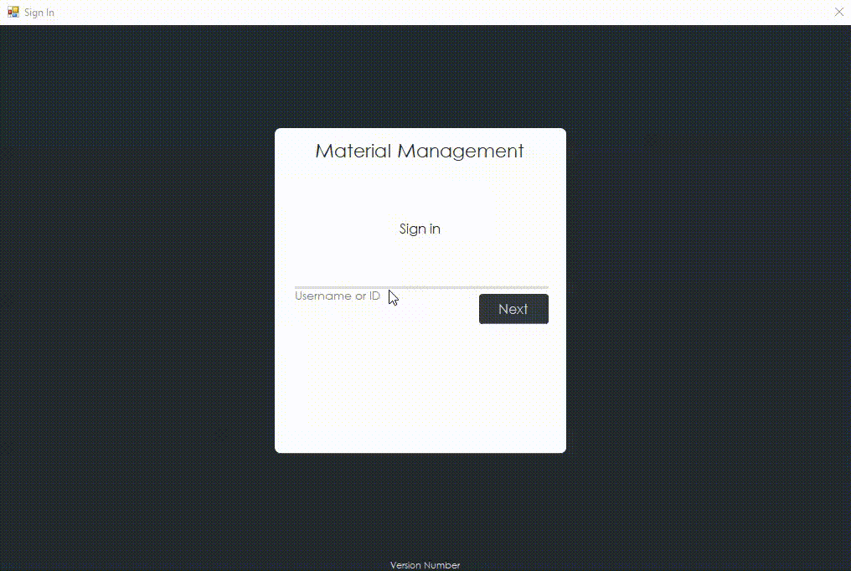
User Interface – Log in

Slide 5
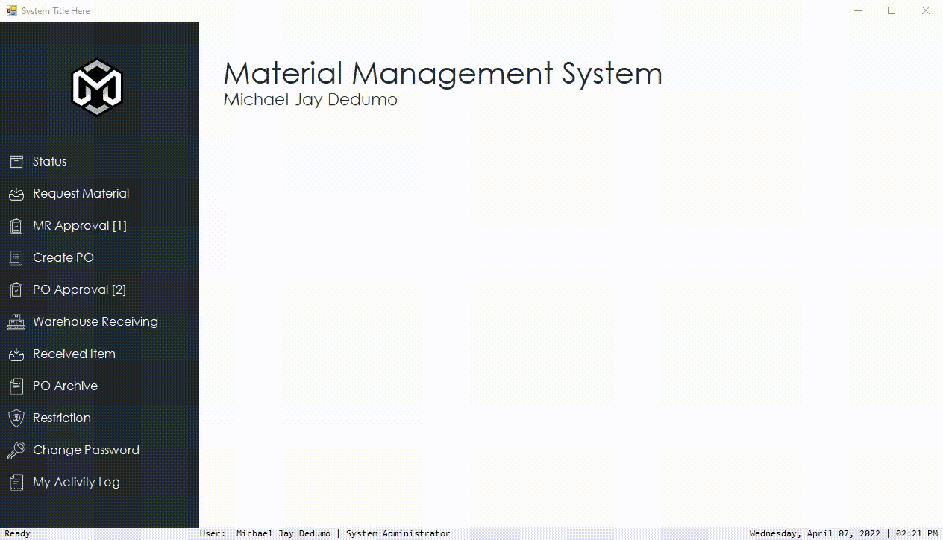
User Interface – Main form
System name
Menu

Slide 6

User Interface- Status

Slide 7
Process Visualization
Requestor
Mail Notification
For Review
Mail Notification
For Approval
Create PO
Notify Requestor /
End User
WH Receiving
Forward PO to
Supplier
Top management
Review and Approval

Slide 8

User Interface – Request Material
Requestor

Slide 9
Process Visualization
Requestor
Mail Notification
For Review
Mail Notification
For Approval
Create PO
Notify Requestor /
End User
WH Receiving
Forward PO to
Supplier
Top management
Review and Approval

Slide 10
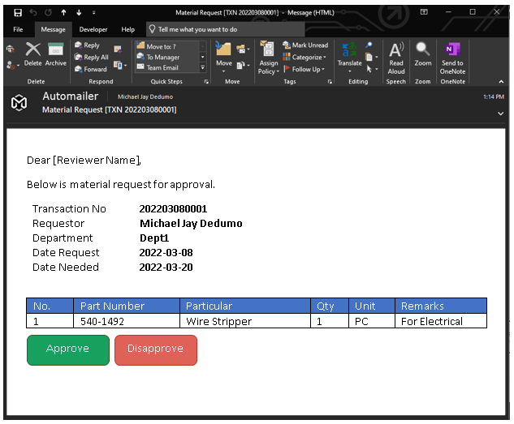
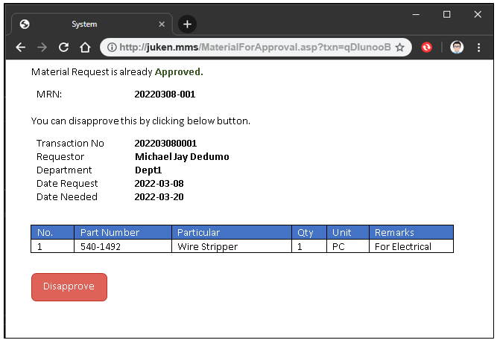
Mailer Material Request Review / Approve
Mail Notification
For Review
Mail Notification
For Approval

Slide 11

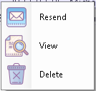
User Interface – Material Request Approval

Slide 12
Process Visualization
Requestor
Mail Notification
For Review
Mail Notification
For Approval
Create PO
Notify Requestor /
End User
WH Receiving
Forward PO to
Supplier
Top management
Review and Approval

Slide 13
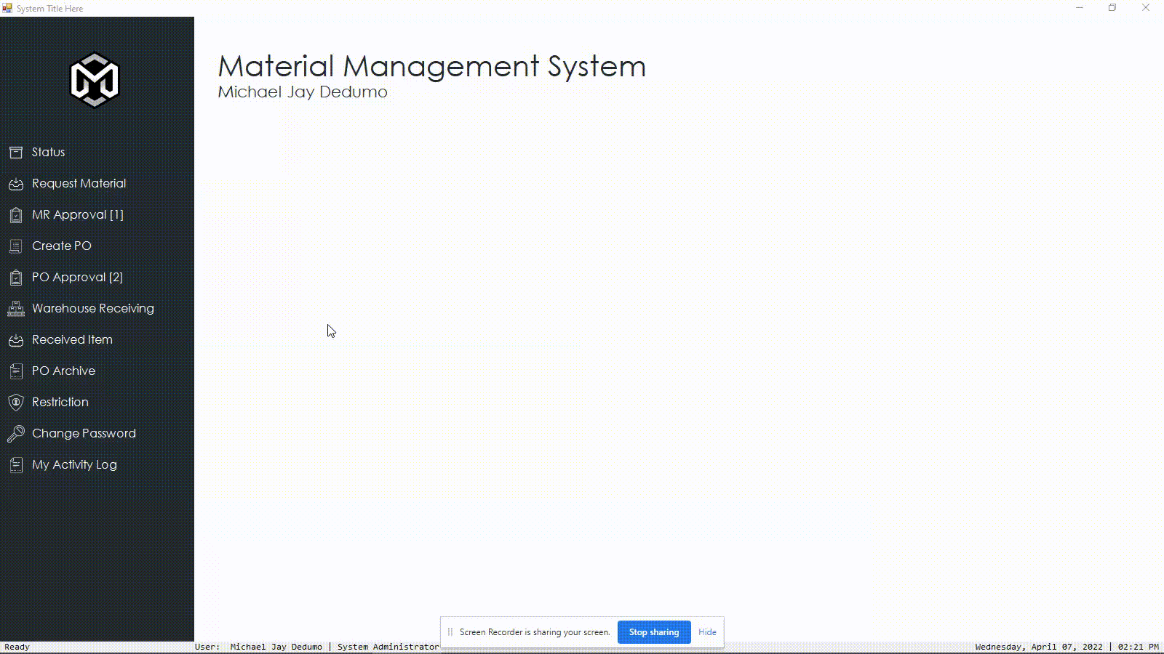
User Interface – Create Purchase Order
Create PO

Slide 14
Process Visualization
Requestor
Mail Notification
For Review
Mail Notification
For Approval
Create PO
Notify Requestor /
End User
WH Receiving
Forward PO to
Supplier
Top management
Review and Approval

Slide 15
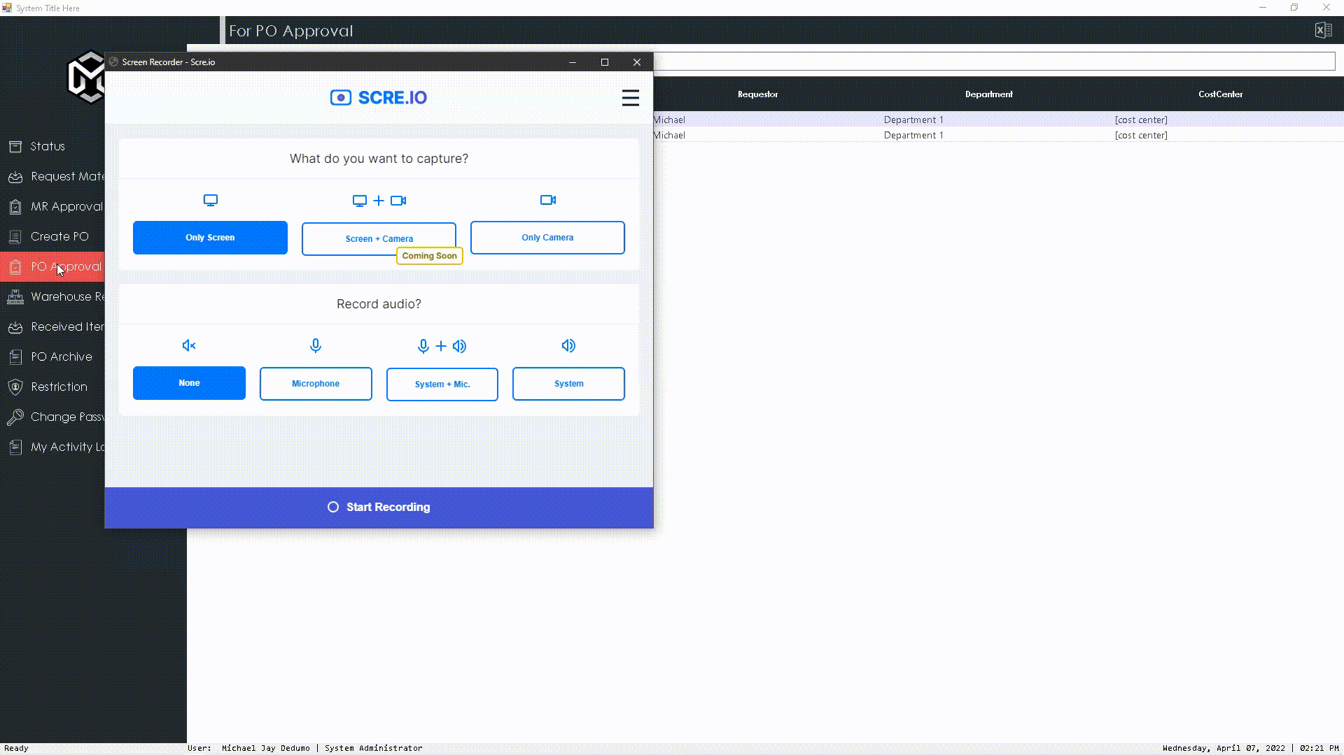
User Interface – PO Approval
Forward PO to
Supplier
Top management
Review and Approval

Slide 16
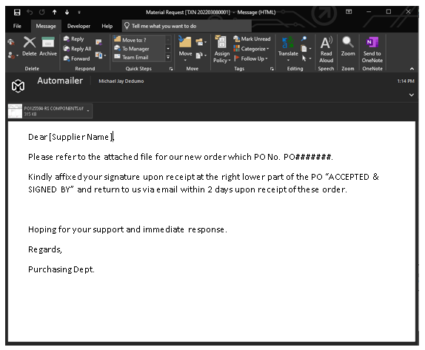
Mailer – Mail to supplier

Slide 17
Process Visualization
Requestor
Mail Notification
For Review
Mail Notification
For Approval
Create PO
Notify Requestor /
End User
WH Receiving
Forward PO to
Supplier
Top management
Review and Approval

Slide 18
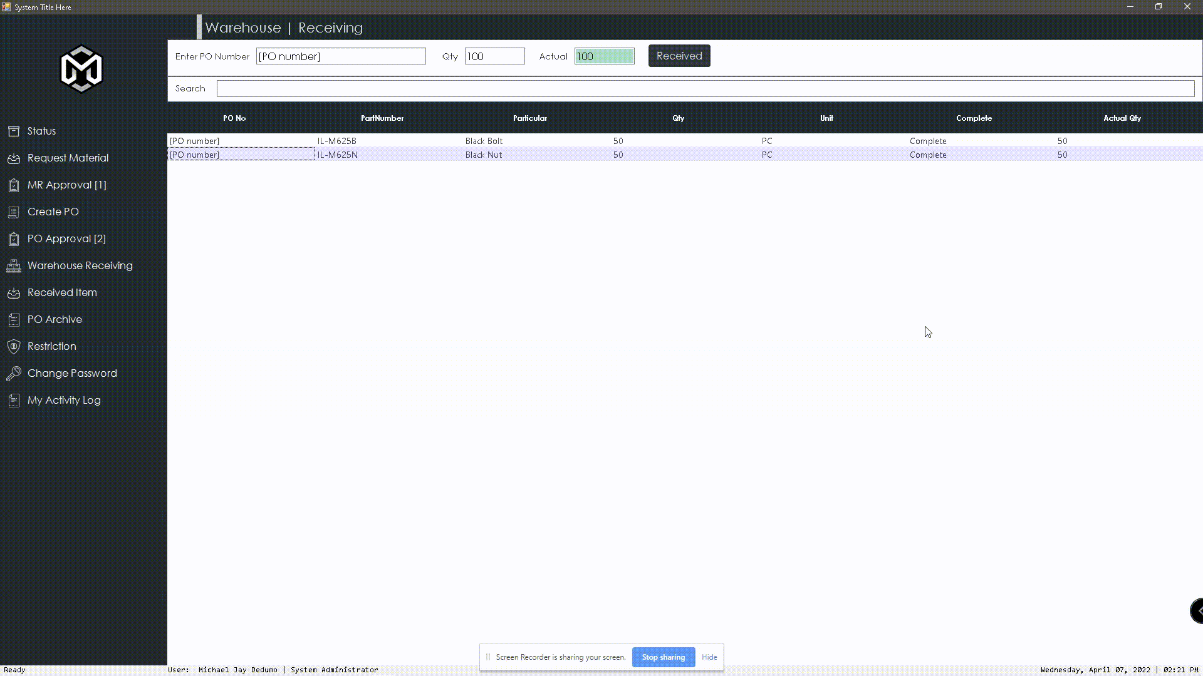
User Interface - Warehouse Receiving
WH Receiving

Slide 19
Process Visualization
Requestor
Mail Notification
For Review
Mail Notification
For Approval
Create PO
Notify Requestor /
End User
WH Receiving
Forward PO to
Supplier
Top management
Review and Approval

Slide 20
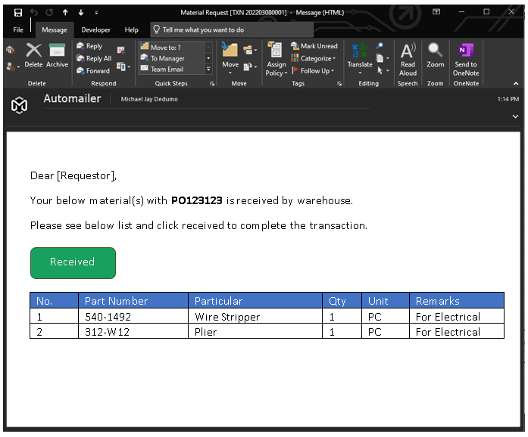
Requestor
Notify Requestor /
End User

Slide 21
Other Functions of the system
User Management
Activity Log
PO Archive
List of Materials
List of Signatories
List of Department
List of Cost Center
Different kind of Reports
Export to Excel

